Slide 1
International Program – Solvay Brussels School of Economics and Management
David Raymaekers
Academic Coordinator – Economics
Matthieu Gilson
Academic Coordinator – Management

Slide 2
Who we are
Academic coordinators
Economics: David Raymaekers draymaek@ulb.ac.be
Management: Matthieu Gilson matgilso@ulb.ac.be
Role
Advise incoming students on their course program at the SBS-EM
Ask questions by email or during the office hours
Validate the “Registration Form” and the “Learning Agreement” (only for Erasmus Students).
2 |
International Program – Welcome Presentation

Slide 3
Your job
Choose your courses
At least 1 course, 30 ECTS maximum, 60% in the SBS-EM catalogue
Go to the classes you are interested in
Fill in the online form and register to these courses
Come to one of the office hours to sign it
We will print them for you
If you are from an European institution, fill in a Learning Agreement and bring it to on the office hours
All documents have to be finalized for February, 14 (easy to remember)

Slide 4
Visiting Hours: when
From 12:00 to 14:00:
Tuesday 05/02
Thursday 07/02
Tuesday 12/02
Thursday 14/02 (last day!!)
Schedule is also on the website:
http://www.ulb.ac.be/facs/sbsem/exchangestudents/coursesinformation/coordinators.html

Slide 5
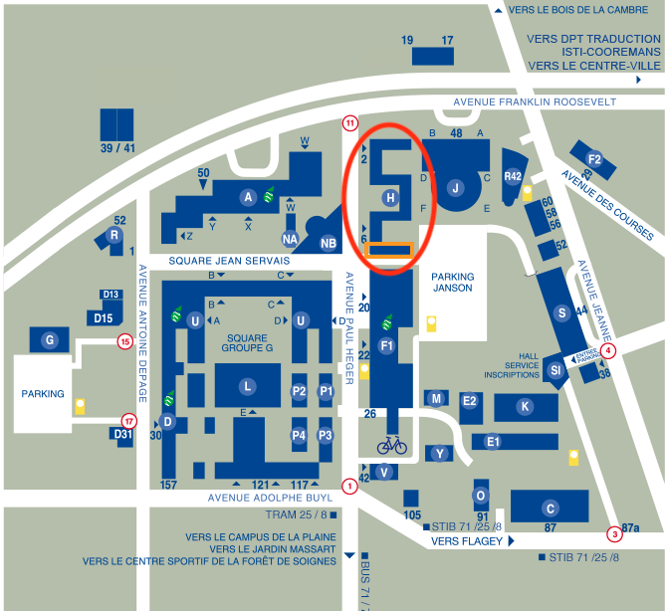
Visiting Hours: where
Room: H4.164 (H building – 4th floor)
5 |
International Program – Welcome Presentation

Slide 6
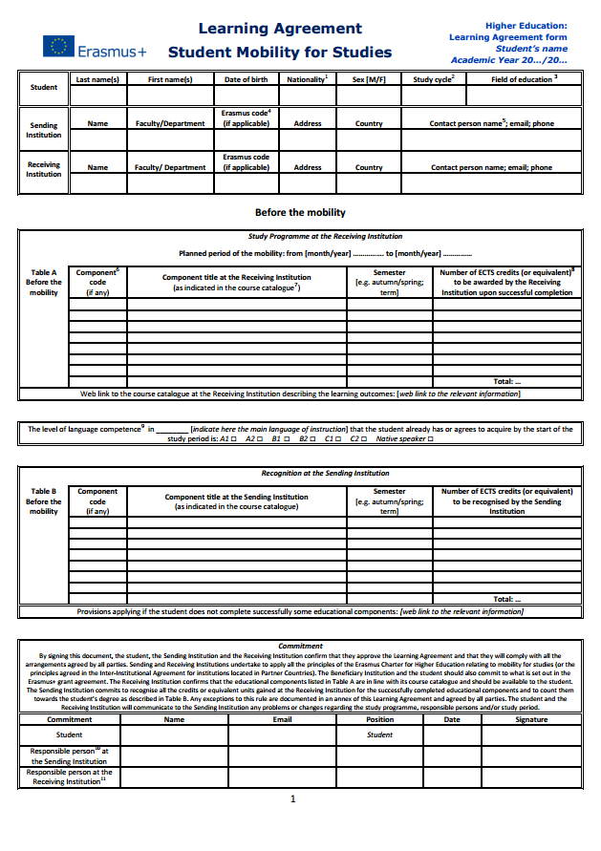
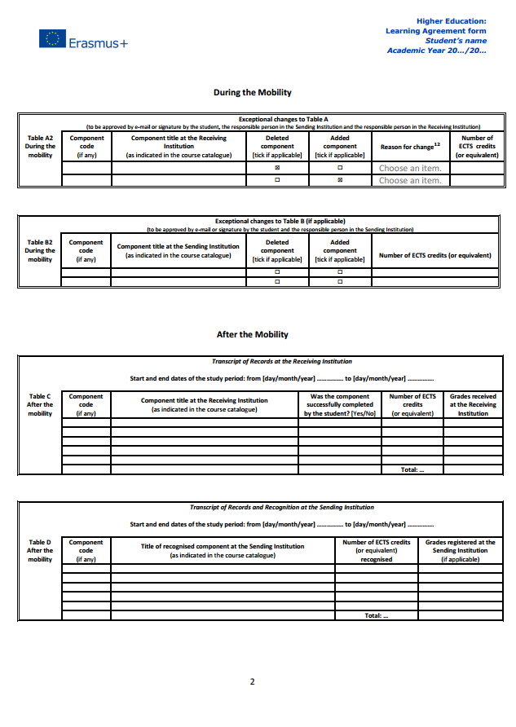
The learning agreement
Only for students from an European institution
You should have submitted a preliminary version before your arrival here.
If you have made any change to this version, you need to fill in the part called ‘During the mobility’
6 |
International Program – Welcome Presentation

Slide 7
Latest updates
Field project in European regulation: Available on demand
Advanced topics in macroeconomics: Available on demand
=> Serious motivation!

Slide 8
A few words on the courses
Professors enjoy a large freedom regarding the organization of their courses:
Different type of classes/activities
Theoretical classes, exercise sessions, seminars,…
Visible on Gehol (blue = theoretical, green = exercises)
Different type of assessments:
Exams (written or oral), assignments, group projects, presentations
Different policies:
Attendance, participation, etc.
Everything is explained during the first session of each course.
8 |
International Program – Welcome Presentation

Slide 9
Do’s and Don’ts
Typical mistakes from exchange students:
Missing first classes
Be sure to know when your courses start and be there. It is a moment where important information are communicated.
Not knowing the “rules” of their courses (attendance, exams, tests, group projects,…)
Be sure to know what is expected of you
Travelling too much…
➔ Missing administrative deadlines, tests, etc. because you are on holidays is never an excuse. Check the schedule of the first term to know when you have free time.

Slide 10
Do’s and Don’ts
Not talking enough with local students
They sometimes have inside information
Waiting the last day to submit their learning agreement.
Come as soon as your documents and your course program is finalized in order to avoid queues.
Waiting too much to get in touch with their home university to get courses approved
Be sure that your home university will give you a answer before the deadline
Underestimate the amount of work that final exams require

Slide 11
Course schedule
Go to Gehol ➔ http://gehol.ulb.ac.be/gehol/
Schedule/classrooms might change ➔ always check Gehol before attending a course (especially the first class)
Classroom ➔ ex.: S.R42.5.503 ➔ Campus(Solbosch).Building(R42).Level(Fifth level).Room (503)
S.H4.164: Campus (Solbosch). Building H. Level (Fourth level). Room(164)
11 |
International Program – Welcome Presentation

Slide 12
Crucial websites
International Program’s Website
Gehol
MonULB
Université virtuelle
Course Catalogue
Professors’ personal websites
Example: Online form
12 |
International Program – Welcome Presentation

Slide 13
Final remark
Stay connected !!!
MonUlb, https://mon-ulb.ulb.ac.be/cp/home/displaylogin
or your ULB mailbox, https://roundcube.ulb.ac.be/
13 |
International Program – Welcome Presentation

Slide 14
Any Questions?

